Slide 1

CCSv6 Fundamentals Workshop for CC2650
Lab Handbook

Slide 2
Outline
Lab Requirements and Setup
Lab 1A: Getting Started: LCD SmartRF06EB Example
Lab 1B: More Basics: LCD SmartRF06EB Example
Lab 2: Basic Debug: Pin Interrupt Example
Lab 3A: Real-time Debug: LCD SmartRF06EB Example
Lab 3B: ROV: LCD SmartRF06EB Example
Lab 4: Multi-target Debug: Per Test Example

Slide 3
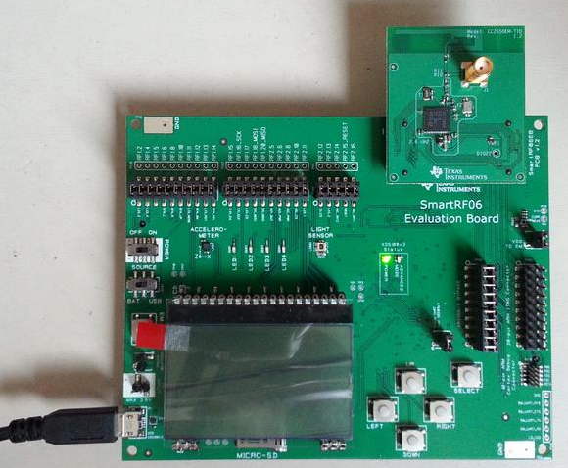
LAB Requirements
Software:
Code Composer Studio v6.1.0 or greater
With all Wireless Connectivity components installed
TI-RTOS for SimpleLink Wireless MCUs
Per Test package
Hardware:
CC2650EM-7ID with SmartRF06EB
Device rev PG 2.2+
Lab 4 requires two such targets!
Power Switch
USB JTAG Connection

Slide 4
LAB Material Notes
It is assumed the main workshop directory is located in C:\ccsv6_workshop\cc2650\workspace
It is assumed that that Per Test is installed in C:\ccsv6_workshop\cc2650\per_test
The lab material will make references to these directory
If the lab material is located in a different location, please update the path to reflect your environment

Slide 5




LAB Conventions
Before starting, it is important to review some lab conventions that will ease your work…
Lab steps are in black and numbered for easier reference
…
…
Explanations, notes, warnings are written in blue
Warnings are shown with
Information is marked with
Tips and answers are marked with
Questions are marked with
Notes:
5

Slide 7
Lab 1A: Getting Started: LCD SmartRF06EB Example 15 minutes
Notes:
7

Slide 8
LAB 1A: Exercise Summary
Key Objectives
Import and build the LCD SmartRF06EB example program
Start a debug session and load/flash the program to the target
Run the program
Tools and Concepts Covered
Workspace
Resource Explorer
Building example projects
Running example projects
Notes:
8

Slide 9

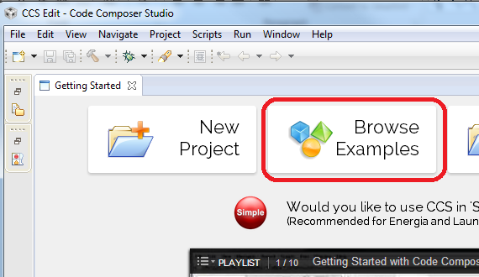
Launch CCS and Open Resource Explorer
Double click on the Code Composer Studio desktop icon
Specify C:\ccsv6_workshop\cc2650\workspace as the workspace location
Select Browse Examples in the Getting Started page

Slide 10
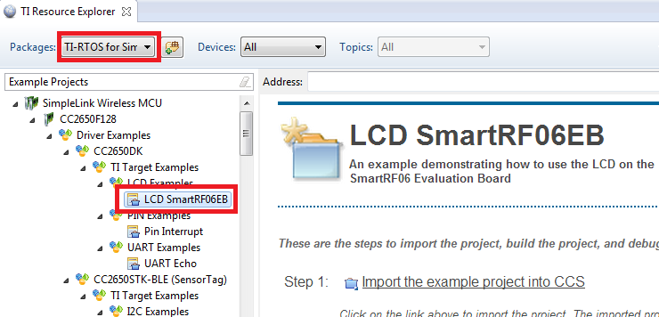
Resource Explorer: Examples
Displays all example projects discovered by the Resource Explorer
Step by step instructions on how to build/run the examples
Select the LCD SmartRF06EB example under TI-RTOS for SimpleLink Wireless MCUs -> SimpleLink Wireless MCU -> CC2650F128 –> Driver Examples -> TI Target Examples -> LCD Examples

Slide 11
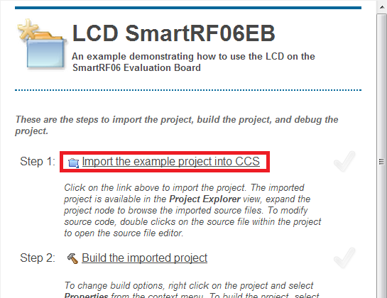
Step 1: Import LCD SmartRF06RB Project
Follow Step 1 and import the LCD SmartRF06RB project into the CCS Workspace by clicking on the Import the example project into CCS link

Slide 12

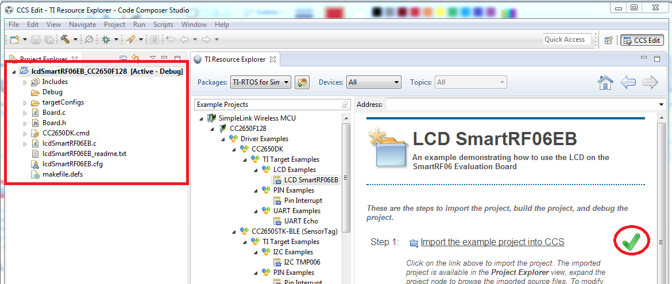
Step 1: Import LCD SmartRF06RB Project
The project will appear in the Project Explorer if the import is successful and a green checkmark will appear next to the link to indicate success

Slide 13
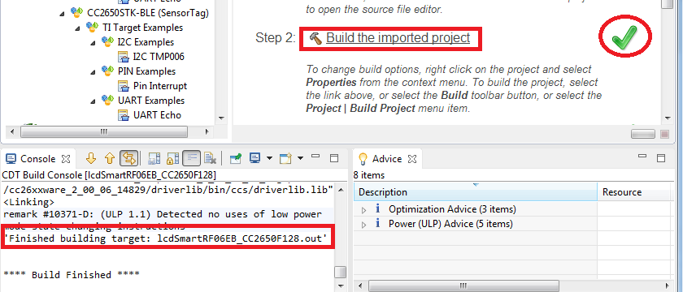
Step 2: Build LCD SmartRF06RB Project
Follow Step 2 and build the LCD SmartRF06RB project by clicking on the Build the imported project link
The build Console view will appear along the bottom with build messages as the project builds
If the build is successful, a green checkmark will appear next to the link to indicate success

Slide 14
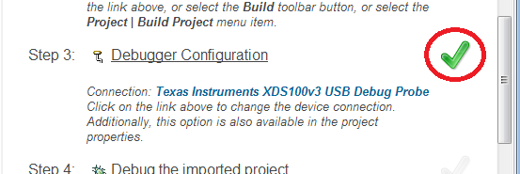
Step 3: Specify Debugger Configuration
Note that a green checkmark exists for Step 3 since the Connection type is already defined
The emulator connection is already specified in the project properties and a target configuration was generated on project import (Step 1)

Slide 15
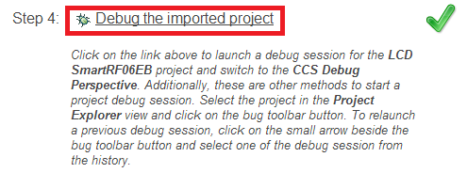
Step 4: Debug LCD SmartRF06RB Project
Follow Step 4 and debug the project by clicking on the Debug the imported project link
Several actions are done automatically
Prompt to save source files
Build the project (incrementally)
Start the debugger (CCS will switch to the CCS Debug perspective)
Connect CCS to the target
Load (flash) the program on the target
Run to main
Don’t want it to do all of the above at once? You can configure it to skip some steps (Debugger Options)

Slide 16
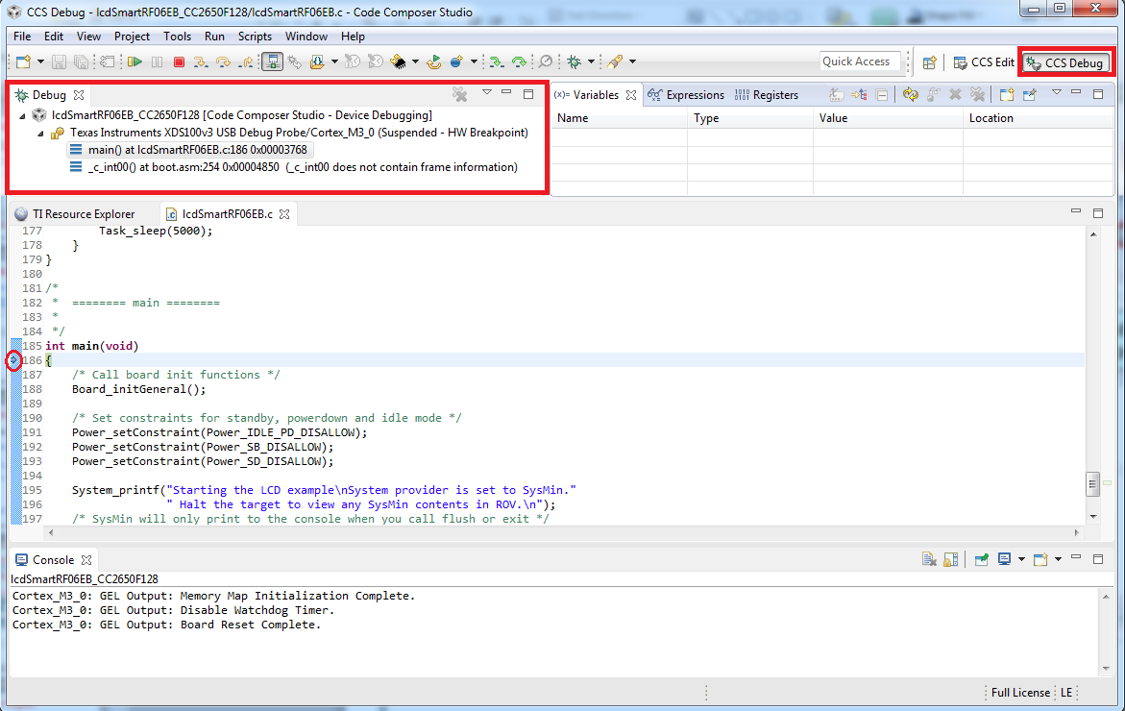
Debug Session for LCD SmartRF06RB Project
Target execution toolbar
Switched to CCS Debug perspective
Debug view for project being debugger
Program counter at main
Debug messages in the Console view
Notes:
16

Slide 17
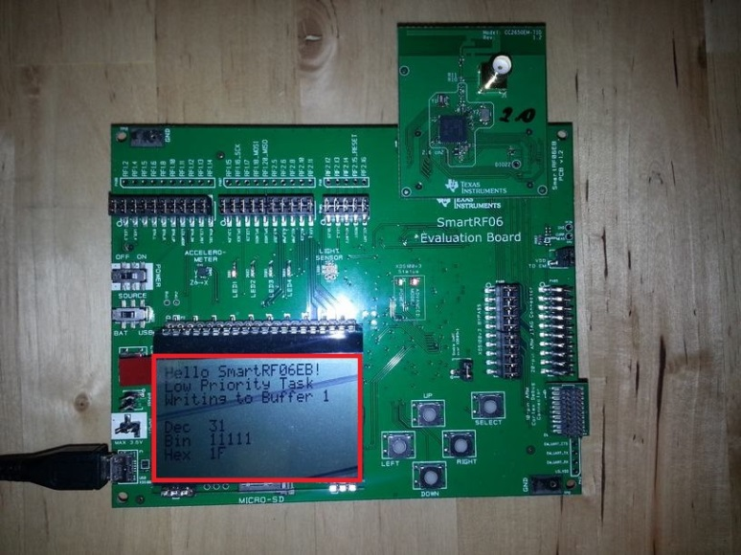
Run LCD SmartRF06RB Program
Press the Resume button (in the target execution toolbar) to run the program
Program will run and text will be displayed to the LCD
Press the Suspend button to halt the target
Press the Terminate button to terminate the debugger
This will terminate the debug session and switch back to the CCS Edit perspective
Notes:
17

Slide 18
LAB1A: Summary
In this lab we completed the following:
Used the Resource Explorer to import build and debug the LCD SmartRF06EB example
Notes:
18

Slide 20
Lab 1B: More basics: LCD SmartRF06EB Example 15 minutes
Notes:
20

Slide 21
LAB 1B: Exercise Summary
Key Objectives
Use the Memory Allocation view to determine code size usage
Analyze the advice from the Optimizer Assistant in the Advice view
Enable optimization in the Project Properties
Get familiar with Simple Mode
Tools and Concepts Covered
Memory Allocation view
Optimizer Assistant
Advice view
Project Properties
Simple Mode
Notes:
21

Slide 22
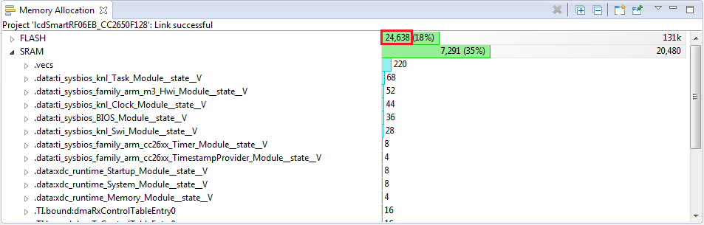
View: Memory Allocation
Open the Memory Allocation view via View -> Memory Allocation
The Memory Allocation view is a graphical display of the memory allocation of the program
Note the total allocation size in FLASH
Numbers may vary slightly in your environment
Notes:
22

Slide 23
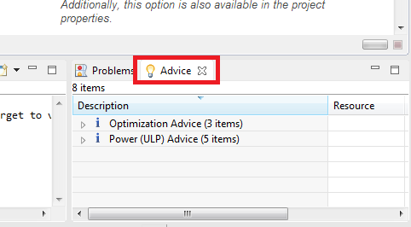
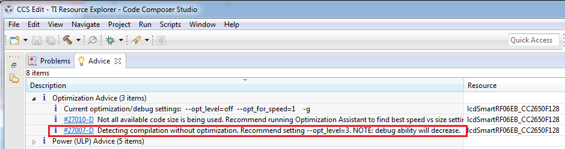
Advice View
Maximize the Advice view in the lower right corner by double-clicking on the tab for the window
The Advice view provides advice on how to better optimize the code for size/performance/power
Expand the Optimization Advice node and resize the Description column so that the advice is more visible
Note the third advice, on how optimization is disabled and level 3 optimization is recommended, and double-click on it
Double-click on the advice itself and not on the hyperlink (#27007-D)
23

Slide 24
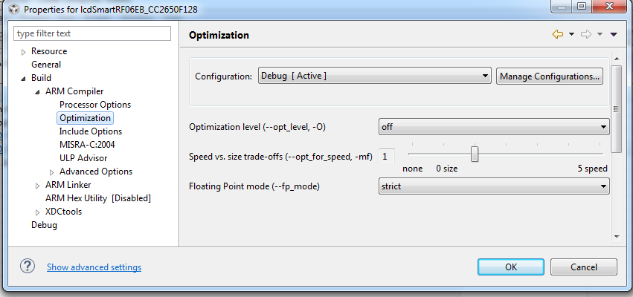
Project Properties
The Project Properties dialog will be opened to the compiler optimization settings
Options such as compiler/linker settings, pre/post build steps, and project dependencies can be set from this dialog
The dialog can also be opened by right-clicking on a project in the Project Explorer view and selecting Properties
Device and high level settings
Compiler Options
Linker Options

Slide 25
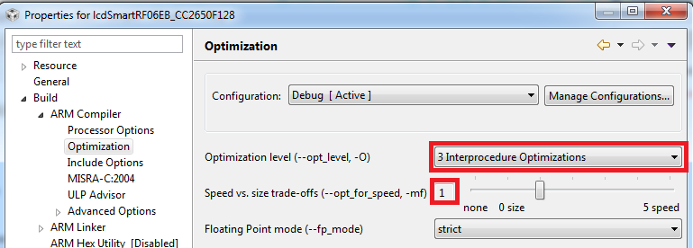
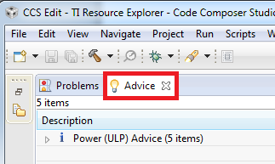
Project Properties
Change the Optimization level to 3
Press OK to apply the changes and exit the dialog
Double-click on the Advice window tab to restore the Advice window back to the original size
Note optimization ‘speed vs size trade-off’ setting favors smaller code size

Slide 26
Debug vs Optimization Tradeoff
The higher the level of optimization (speed/size/power), the greater the negative impact in debug visibility/experience
Trade-off between the ease of debugging and the effectiveness of compiler optimization
Best trade-off point depends on user preference… but usually the lowest level of optimization which meets your system constraints
Use the lowest optimization setting if debug visibility is the highest priority (debugging difficult bugs in application behavior)
Some impact on the debug experience for highly optimized code:
Source-line setting is erratic (code has been removed/rearranged)
Unable to set source-line breakpoints (code has been removed/rearranged)
Unable to view certain variables (variables optimized out)
For more details:
http://processors.wiki.ti.com/index.php/Debug_versus_Optimization_Tradeoff

Slide 27
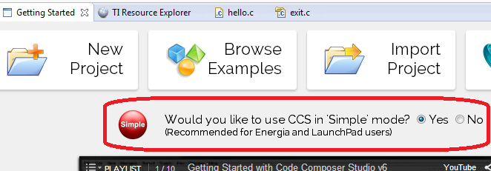

Switch to Simple Mode
Select the option to enable Simple Mode in the Getting Started page (View -> Getting Started)
This will switch the perspective to the CCS Simple perspective
27

Slide 28
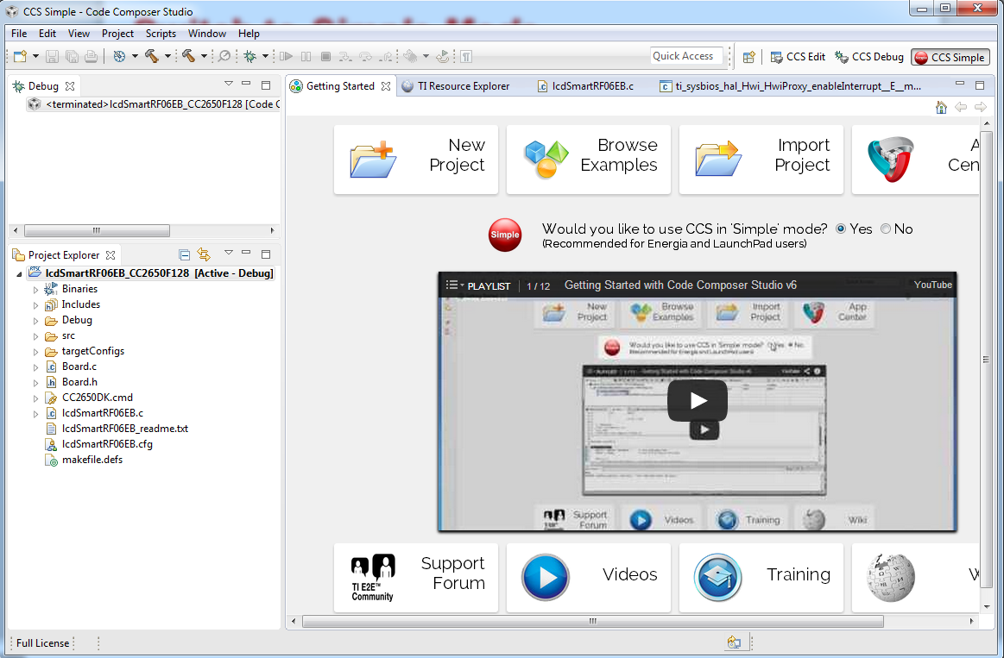
Simple Mode
Simple Mode is a simplified Perspective that combines the key views and menus of the CCS Edit and CCS Debug perspectives into one view for those that want a simpler interface and wish to avoid the constant Perspective switching
Debug view
Project Explorer view
28

Slide 29
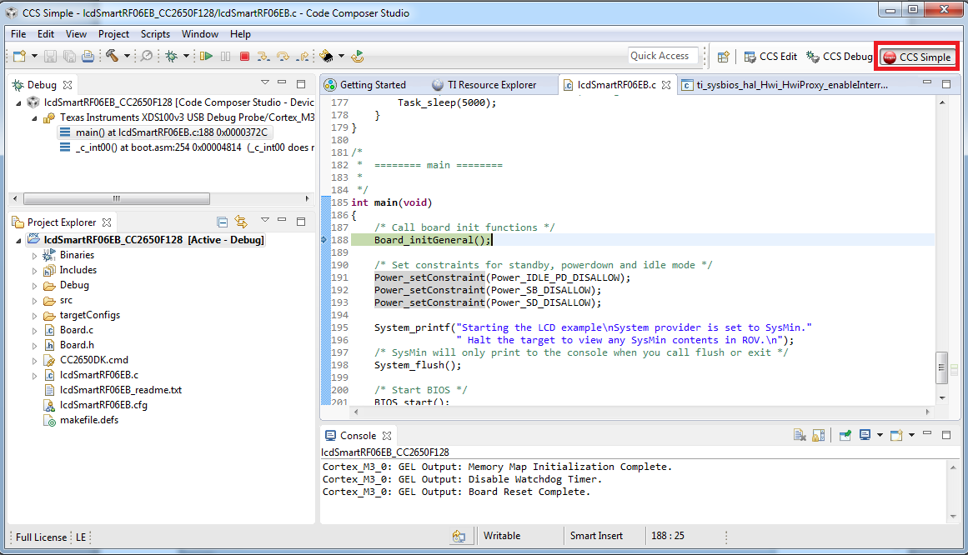
Debugging in Simple Mode
Use the Debug button to rebuild, load and run the program to main
Press the Resume button to run the program
Check LCD on target to confirm program is running correctly
Note that there is no perspective switch in Simple Mode

Slide 30
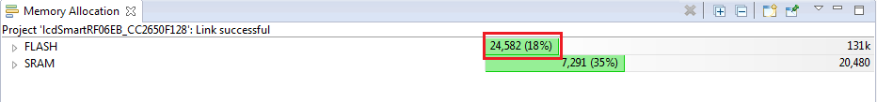
View: Memory Allocation
Open the Memory Allocation view via View -> Other… -> Code Composer Studio -> Memory Allocation
The Memory Allocation view is hidden in the default Simple Mode perspective, hence the need to go to View -> Other…
Note the total allocation size in FLASH
Code size for FLASH decreased after optimization is enabled
Numbers may vary slightly in your environment
Notes:
30

Slide 31
Clean Up
Press the Suspend button to halt execution
Terminate the Debug Session
Disable Simple Mode in the Getting Started page (View -> Getting Started)
The rest of the workshop will not use Simple Mode but instead use the default CCS Edit and CCS Debug perspectives

Slide 32
LAB 1B: Summary
In this lab we completed the following:
Became familiar with the Memory Allocation view
Used Optimizer Assistant and the Advice view to help optimize the program
Became familiar with Project Properties
Became familiar with Simple Mode
Notes:
32

Slide 34
Lab 2: basic debug: Pin Interrupt Example 30 minutes
Notes:
34

Slide 35
LAB 2: Exercise Summary
Key Objectives
Debug the Pin Interrupt example
Basic Profiling
Tools and Concepts Covered
Basic Debug
Breakpoints/Watchpoints
Event Counters
Notes:
35

Slide 36
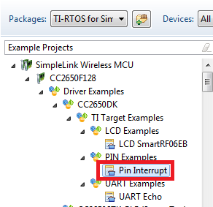
Resource Explorer: Pin Interrupt Example
Open Resource Explorer via View -> Resource Explorer (Examples)
Select the Pin Interrupt example under TI-RTOS for SimpleLink Wireless MCUs -> SimpleLink Wireless MCU -> CC2650F128 –> Driver Examples -> TI Target Examples -> PIN Examples
Follow the steps to import, build and debug the project

Slide 37
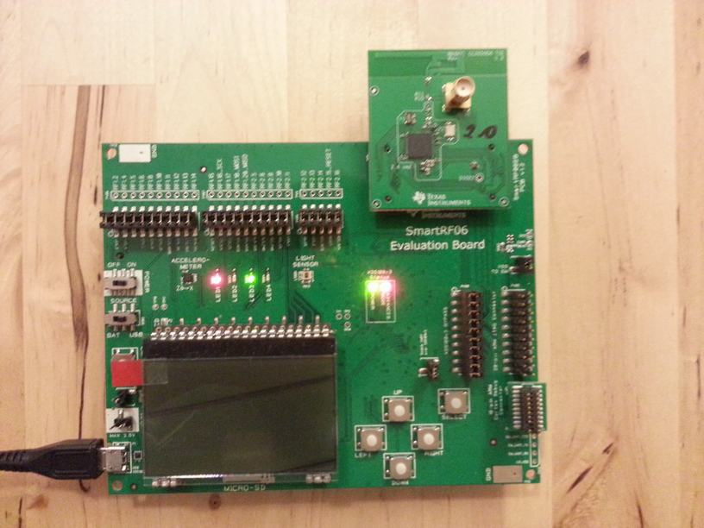
Run Pin Interrupt Program
Press the Resume button to run the program
This example uses interrupts to toggle LEDs 1-4 when one of the directional (or SELECT) button(s) are pressed
Play with the example by pressing the directional/SELECT buttons and observe the behavior of the LEDs
Notes:
37

Slide 38
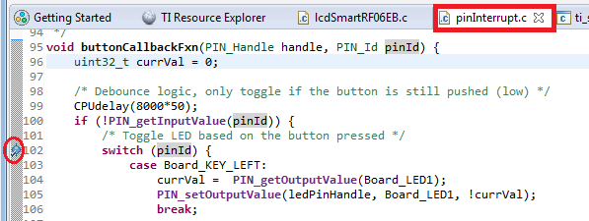

Debugging: Using Breakpoints
Press the Suspend button to halt execution
Set a breakpoint on line 102 of pinInterrupt.c by double-clicking in the editor margin
Press the Resume button to run the program again
Press any of the directional (or SELECT) button
Note that the target will be halted at the breakpoint location
Double-click on the breakpoint to remove it
The default behavior is to use a software breakpoint unless the program address is in a memory region known to the debugger as read-only memory (as in this case) by the debugger memory map
Notes:
38

Slide 39
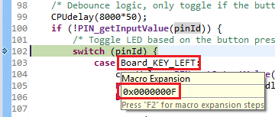
Debugging: Using Watchpoints
A Watchpoint is a type of breakpoint that monitors activity at a memory address
In this step we will halt the CPU only when the LEFT button is pressed by setting a watchpoint to halt the CPU
Hover your mouse cursor over the Board_KEY_LEFT macro on line 103 an wait for the tool tip pop-up to get the value of the macro
If the tool tip pop-up is not appearing, try double-clicking the macro to highlight it and hover over it again
Notes:
39

Slide 40
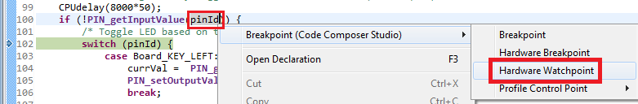
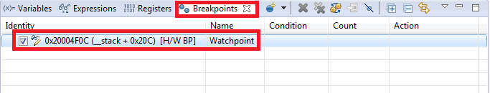
Debugging: Using Watchpoints
Highlight pinId, right-click and select Breakpoint -> Hardware Watchpoint in the context menu
Notes:
40

Slide 41
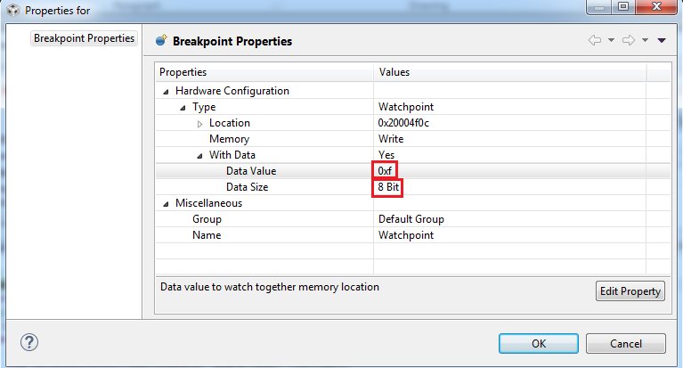
Debugging: Watchpoints
Right-click on the watchpoint in the Breakpoints view and select Breakpoint Properties in the context menu
Modify the properties to match the settings in the screenshot below
Hit OK to apply changes
Notes:
41

Slide 42
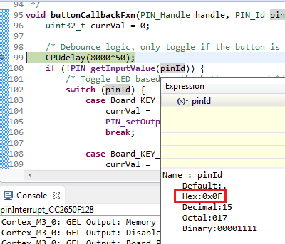
Debugging: Using Watchpoints
Run the target again
Press any directional/SELECT button on the SmartRF06 board except for the LEFT directional button (note the LEDs toggling based on the button pressed)
Press the LEFT directional button and note how the target will halt at line 99 of pinInterrupt.c
Hover the mouse cursor over pinId and note the value in 0xF (hex)
Remove the watchpoint using the Remove All Breakpoints button
Notes:
42

Slide 43
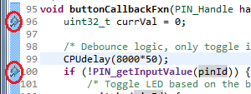
Debugging: Counting Events
Run the target again
Set breakpoints on line 96 and 100 of pinInterrupt.c by double-clicking in the editor margins
Press any directional/SELECT button on the SmartRF06 board
Note that the target has halted at the first breakpoint
Notes:
43

Slide 44
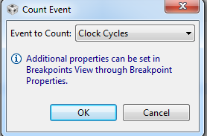

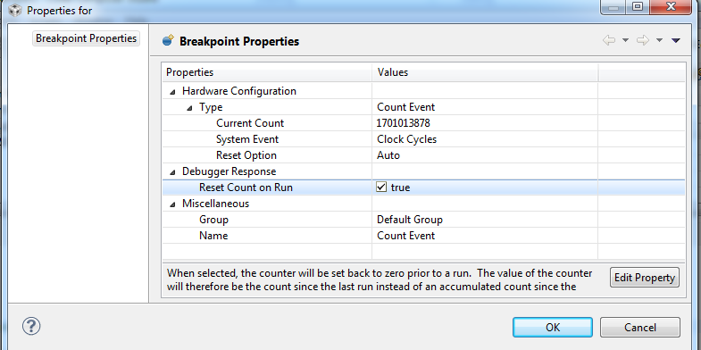
Debugging: Counting Events
Set event counters from the Breakpoints view
Set a event counter to count cycles
Right-click on the event counter in the Breakpoints view and select Breakpoint Properties in the context menu
Enable the Reset Count on Run option in the properties dialog
Press OK

Slide 45
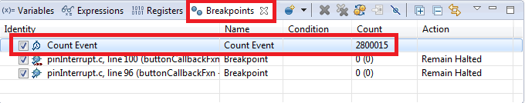
Debugging: Counting Events
Run the target again
The target will halt at the second breakpoint and the event counter will display the number of cycles executed since the last breakpoint
Remove the event counter and breakpoints by using the Remove All Breakpoints button
Notes:
45

Slide 46
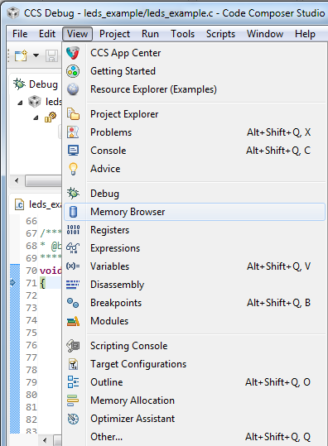
More Debugging (Review)
Investigate other debugging views (Open via View menu)
Memory Browser
Registers
Modules
Disassembly (see next slide)
Notes:
46

Slide 47

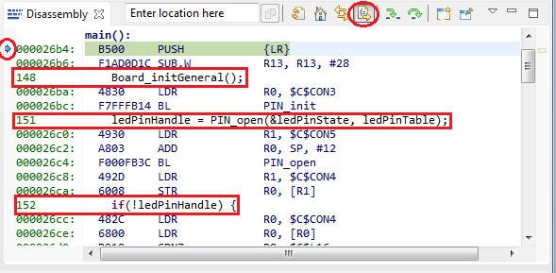
View: Disassembly
Press the Restart button to restart the program
Program should be at main
Open the disassembly view by going to View -> Disassembly
You can see the current location of the PC (small blue arrow) and any breakpoints (small blue circles)
Toggle the Show Source button
Note the toggling of interleaved source with the disassembly
Notes:
47

Slide 48
Clean Up
Remove all breakpoints from the Breakpoints view (if any)
Terminate the Debug Session

Slide 49
LAB 2: Summary
In this lab we completed the following:
Learned how to use breakpoints and watchpoints
Learned how to count events (cycles)
Became familiar with the Disassembly view
Notes:
49

Slide 51
Lab 3A: REAL-TIME DEBUG: LCD SmartRF06EB Example 15 minutes
Notes:
51

Slide 52
LAB 3A: Exercise Summary
Key Objectives
Demonstrate how to access memory in real time when processor is running
Tools and Concepts Covered
Real-time access to memory
Continuous refresh in views
Notes:
52

Slide 53
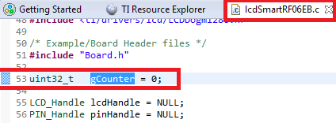
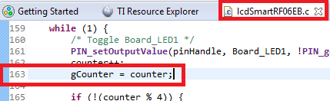
Editing the Source Code
Open lcdSmartRF06EB.c source file in the editor (if not already opened) by double-clicking on the file in the Project Explorer (under the lcdSmartRF06EB_CC2650F128 project)
Insert the following code:
Line 53: uint32_t gCounter = 0;
Line 163: gCounter = counter;
Use the Debug button to rebuild, load and run the program to main
Make sure the lcdSmartRF06EB_CC2650F128 project is selected (has context)!

Slide 54
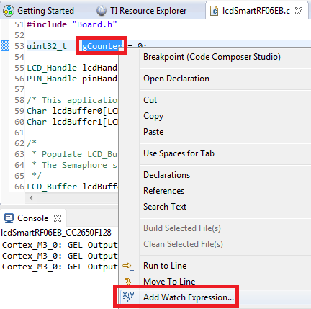
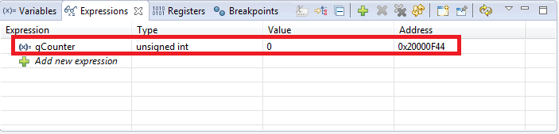
Adding Variables to the Expressions View
Right-click on gCounter on line 53 of lcdSmartRF06EB.c and select Add Watch Expression… to add it to the Expressions view

Slide 55
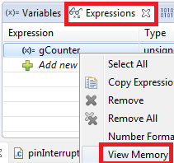
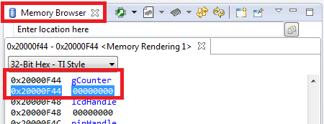
Adding Variables to the Expressions View
Right-click on gCounter in the Expressions view and select View Memory
The Memory Browser will open to the location of gCounter

Slide 56
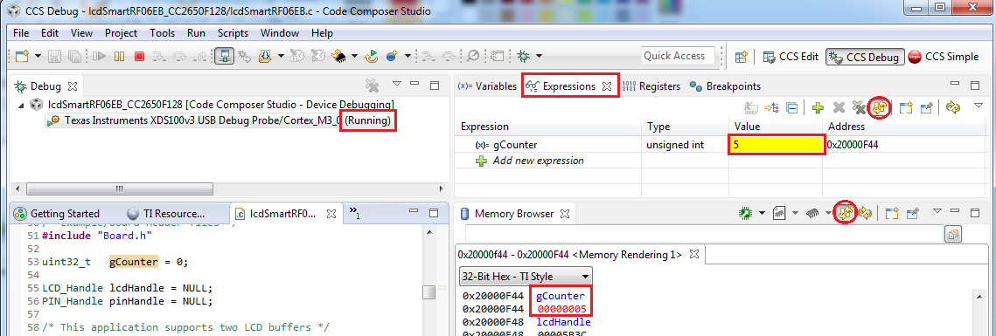
Continuous Refresh
Run the target
Enable Continuous Refresh in both the Expressions view and Memory Browser view
See the values update while the target is running
Halt the target

Slide 57
Clean Up
Restart the program with the Restart button
Leave the application at main for the next lab

Slide 58
Real-Time Access: Summary
After completing this lab you should now be familiar with:
Real-time memory accesses with CCS
How to enable Continuous Refresh in a view
Notes:
58

Slide 60
Lab 3B: ROV 45 minutes
Notes:
60

Slide 61
LAB 3B: Exercise Summary
Objectives
Get familiar with using ROV (RTOS Object View) to inspect state of the scheduler, threads and objects in the system
Tools and Concepts Covered
RTOS Object Viewer (ROV)
Notes:
61

Slide 62
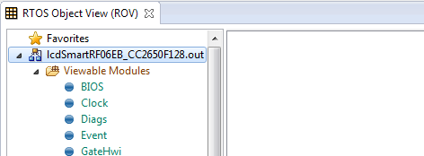
Open the RTOS Object View (ROV)
ROV can be used to inspect state of the scheduler, threads and objects in the system
Go to menu Tools -> RTOS Object View (ROV) to open ROV
In RTOS Object View expand lcdSmartRF06EB_CC2650F128.out

Slide 63
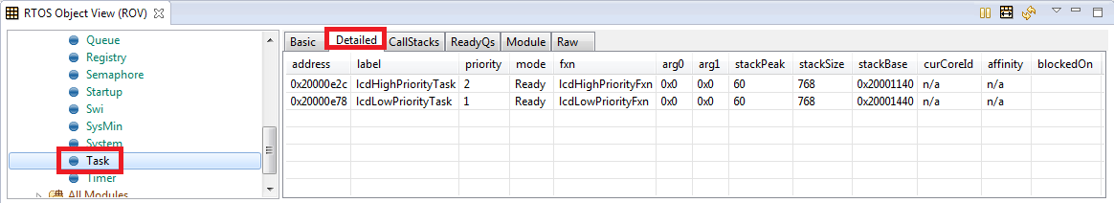
Use ROV
Click on Task to see details of tasks in the system
Check the state of each task (and their stacks) in the system
Answer the following for each task:
What are the priorities and current states/mode?
What is the size of stack and stack peak? (Hint: some info is in Detailed tab)

Slide 64
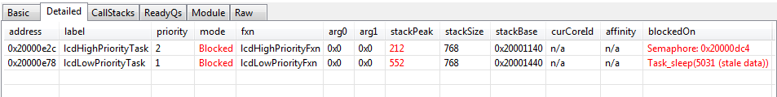
Use ROV
Click the Resume button to run the program
Let it run for ~5 seconds, then click the Suspend button to halt Answer the following for each task again:
What are the current states/mode?
What is the stack peak?

Slide 65
Clean Up
Click on the Terminate button in the Debug view More information on ROV is available at: http://rtsc.eclipse.org/docs-tip/RTSC_Object_Viewer

Slide 66
Exercise Summary
After completing the labs you should be familiar with:
Using ROV (RTOS Object View) to inspect state of threads in the system.
Additional References:
TI-RTOS Users Guide: http://www.ti.com/lit/spruhd4
SYSBIOS Wiki: http://processors.wiki.ti.com/index.php?title=Category:SYSBIOS

Slide 68
Lab 4: multi-target deBug: Per Test Example 45 minutes
Notes:
68

Slide 69
LAB 4: Exercise Summary
Key Objectives
Create a single custom target configuration file for two CC2650F128+SmartRF06EB targets
Learn the basic concepts of:
Target configurations
Project-less debugging
Multi-target debugging
Tools and Concepts Covered
Target Configurations view
Advanced Target Configuration Editor
Starting a project-less debug session
Working with executables generated from other tool chains
Specifying debug source search paths
Multi-target Debug
NOTE: This lab requires two targets (CC2650EM-7ID+SmartRF06EB)
Notes:
69

Slide 70
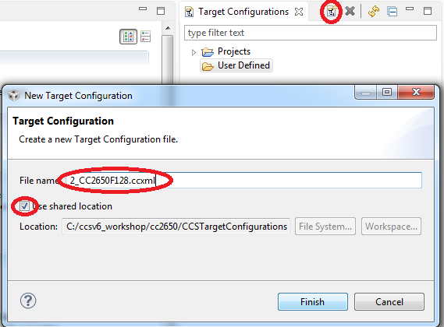
Create a Target Configuration File
Open the Target Configurations view (View -> Target Configurations)
Specify 2_CC2650F128.ccxml as the File name
Ensure that Use shared location is enabled
Hit Finish when done
The Target Configuration Editor will be opened

Slide 71
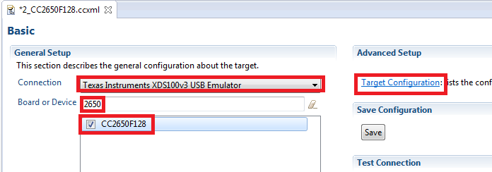
Target Configuration Editor
Set/Enter the following:
Connection: Texas Instruments XDS100v3 USB Emulator
Board or Device search field: 2650 (Select CC2650F128 from the remaining list)
Click on the Target Configuration link to go to the Advanced editor

Slide 72
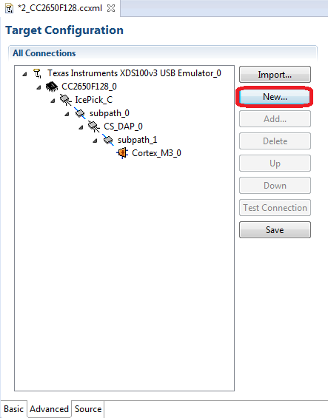
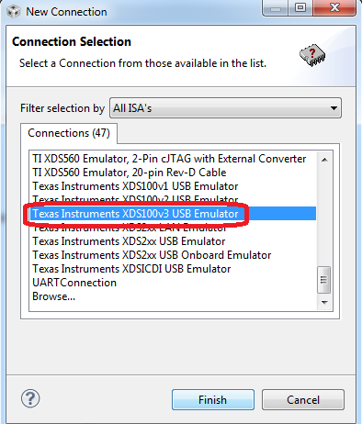
Target Configuration Editor (Advanced)
Press the New… button to add a new connection type
Select Texas Instruments XDS100v3 Emulator in the list of Connections
Press Finish

Slide 73
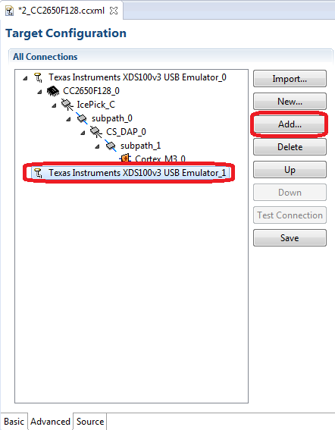
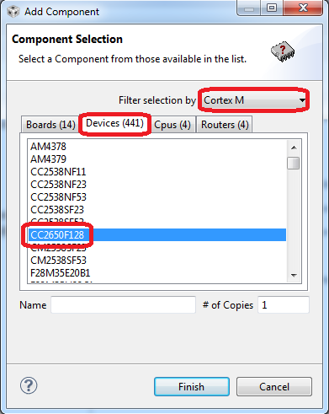
Target Configuration Editor (Advanced)
The new connection has been added
Press the Add… button to add a device
Select Cortex M in the filter list and select CC2650F128 in the list of Devices
Press Finish

Slide 74

Target Configuration Editor (Advanced)
A CC2650F128 device has been added to the new connection and now there are two XDS100v3 connections, each with a CC2650F128 device, configured for this single target configuration
But how does CCS know which XDS100v3 connection applies to which board?
XDS100 emulators can be identified by their serial numbers!

Slide 75

Getting the Serial Numbers for XDS100
Open a command window and browse to the following location:
<CCSv6 INSTALL DIR>\ccsv6\ccs_base\common\uscif
Run the following command:
> xds100serial
All XDS100 connections to the host will be scanned and listed with their serial numbers

Slide 76

Target Configuration Editor (Advanced)
Select the Texas Instruments XDS100v3 USB Emulator_0 node in the left pane
For the Connection Properties, change the Emulator Selection setting to Select by serial number and then enter the first serial number found by the xds100serial utility
Repeat steps 1 and 2 above for XDS100v3 USB Emulator_1 using the other serial number detected
Press Save to save the configuration

Slide 77

Launch the Debugger
Right-click on 2_CC2650F128.ccxml under the User Defined node in the Target Configurations view and choose Launch Selected Configuration
The debugger will be launched – this is known as a project-less debug session since it was originally launched without a project association

Slide 78

Launch the Debugger
A single debug session for BOTH SmartRF06 boards will have started
Note how there are two CPUs that are now visible in the Debug view – one for each CC2650F128 CPU found on the two separate emulator connections

Slide 79



KNOWN ISSUE WITH GROUPS (1)
The rest of the lab steps relies on GROUPS (each M3 core is combined into a single group)
There is a known stability issue with CCSv6.1.0 when trying send a run/resume command to the group
This issue will be resolved in CCSv6.1.1
It is recommended to avoid group level commands (when the group is selected in the Debug view) and send commands individually to each core by manually selecting each node under the group (have to manually repeat the action for each core)
The group (Group 1) is selected above and any debugger command will be issued to the group (group level command)
The first core (or node under core) in the group is selected and any debugger command will be issued to just the first core

Slide 80

KNOWN ISSUE WITH GROUPS (2)
Another option is to simply skip groups all together and always keep the cores separate in the Debug view
Send commands individually to each core by manually selecting each node
The fix for this bug will be available in the next CCS update (6.1.1)
No group created and cores kept separate

Slide 81


Creating Groups
Multi-select the both sub-nodes in the Debug view (press CTRL and then click on each node) and right-click to bring up the context menu
Select Group core(s)
This will group the selected nodes under a new node that represents the group
The group can be selected to broadcast commands to all members of the group
Selecting Group 1 will change the debug context to the whole Group

Slide 82
Working with Groups
Select the Group 1 node in the Debug view and press the Connect Target button to connect to both targets
Select the Group 1 node in the Debug view and press the Load button
In the Load Program dialog, specify the per_test.out program located in:
C:\ccsv6_workshop\cc2650\binary
This will load the program on to both targets
Select the Group 1 node in the Debug view and press the Resume button to run the program on both targets

Slide 83


Working with Groups
Both targets will begin running and the LCD should indicate that the CC2650 PER TEST is running
Feel free to play with the PER test example if desired (see PER test documentation)

Slide 84
Multi-Emulator/Target Debug
CCS treats a multi-emulator debug session the same a single emulator debug session for a multi-core device
Each CPU in the debug session has its own debug context and can be controlled separately
When a CPU has debug context, all actions apply to that CPU and all views display data for that CPU
Groups can be used to control multiple CPUs at once (broadcast commands)

Slide 85

Multi-Core Debug
Select the Group 1 node in the Debug view and press the Suspend button to halt execution of both targets
Select the Group 1 node in the Debug view and press the Restart button to restart the program for both targets
Expand the node for the first CPU under Group 1, to expose the call stack, and select the top entry in the call stack
Select Locate File… to browse to the location of main.c (C:\ccsv6_workshop\cc2650\ per_test\source)
Selecting the first CPU will change the debug context to the first CPU

Slide 86

Breakpoints
Open the Breakpoints view (View -> Breakpoints)
Open the Disassembly view (View -> Disassembly)
In the Disassembly view: Type in menu in the address field and select menuButtonCb in the list of suggestions
The Disassembly view will jump to the address of menuButtonCb

Slide 87


Breakpoints
In the Disassembly view: Scroll down to address 0x68A8 and double-click in the margin to set a breakpoint
This location is reached when the SELECT button is pressed on the SmartRF06RB
This will set a breakpoint for just the first CPU
Contents of Disassembly view is for current debug context (first CPU)

Slide 88


View Breakpoints by Debug Context
In the Breakpoints menu, select Group by -> 4 Debug Contexts
Which CPU does this breakpoint apply to?
Breakpoints are now grouped by debug context (CPU) for easy identification
Notes:
88

Slide 89


Breakpoints – Run Program
Select the Group 1 node in the Debug view and press the Resume button to run the program on both targets
Press the Select button on the SmartRF06 board which represents the first CPU
Note how the first CPU will be halted at the breakpoint while second CPU continues to run

Slide 90
Clean Up
Halt the target
Remove all breakpoints from the Breakpoints view (if any)
Terminate the Debug Session

Slide 91
Multi-Core Target: Summary
After completing this lab you should now be familiar with:
Creating Advanced Target Configuration files
Working with a multi-core debug session
Working with Debug Groups
Working with multiple debug contexts
Working with Breakpoints in a multi-core environment
Notes:
91

